Slide 1
GLOBAL AIR TRANSPORTATION NETWORK
PROJECT REPORT TEMPLATE

Slide 2
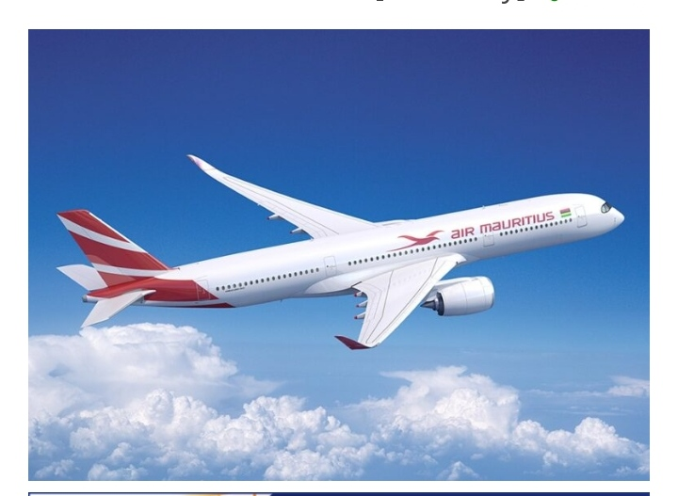
1.1 OVERVIEW
The worldwide air transportation network is a small-world network in which the number of nonstop connections from a given city and the number of shortest paths going through a given city have distributions that are scale-free.
The worldwide air transportation network is a critical infrastructure with high impact on trade and economy.
1. INTRODUCTION

Slide 3
1.2 PURPOSE
Air transport allows people from different countries to cross international boundaries and travel other countries for personal, business, medical and tourism purposes.

Slide 4
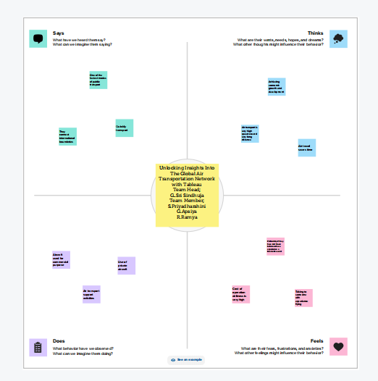
2. PROBLEM DEFINITION & DESIGN THINKING
2.1 EMPATHY MAP

Slide 5
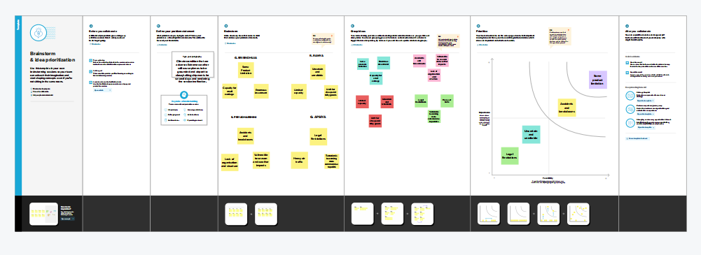
2.2 IDEATION & BRAINSTORMING MAP

Slide 6
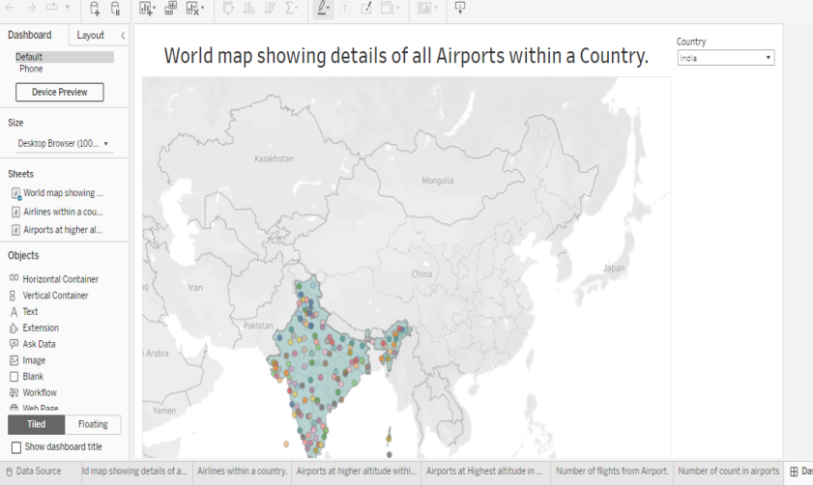
3. RESULT

Slide 7
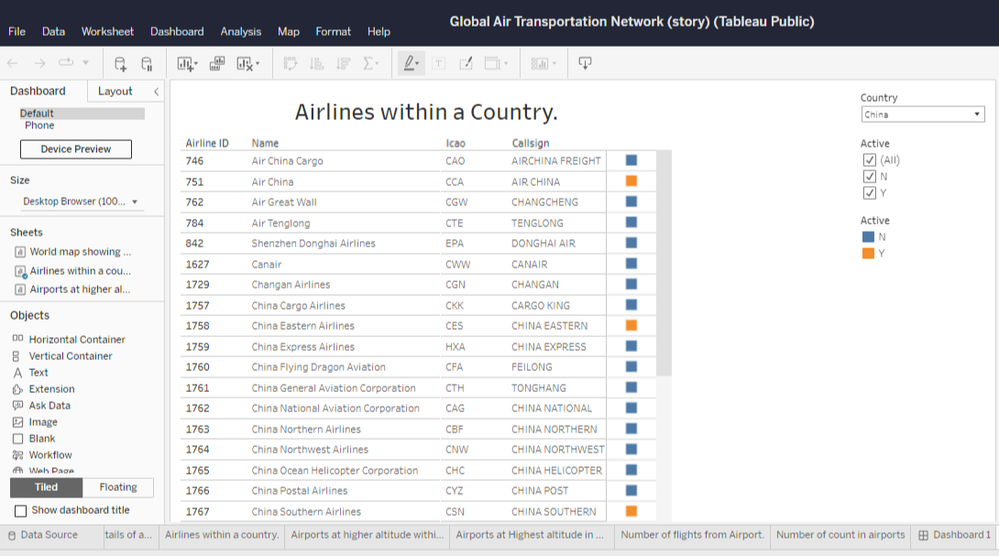

Slide 8
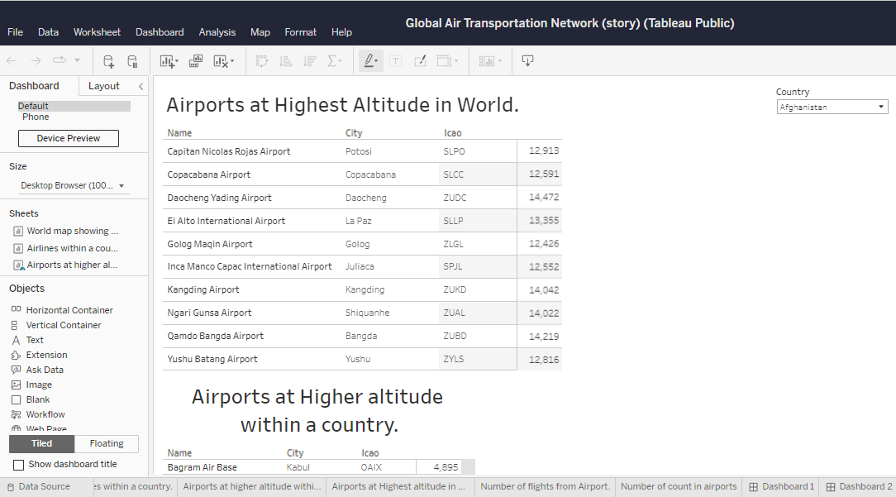

Slide 9
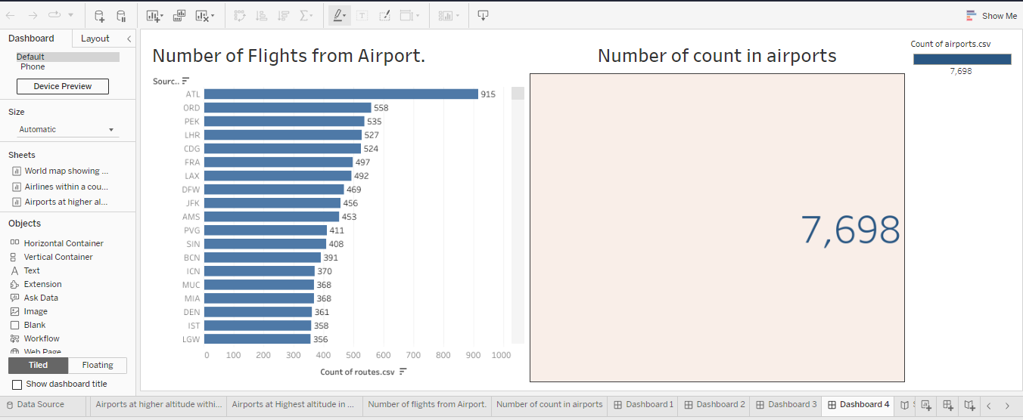

Slide 10
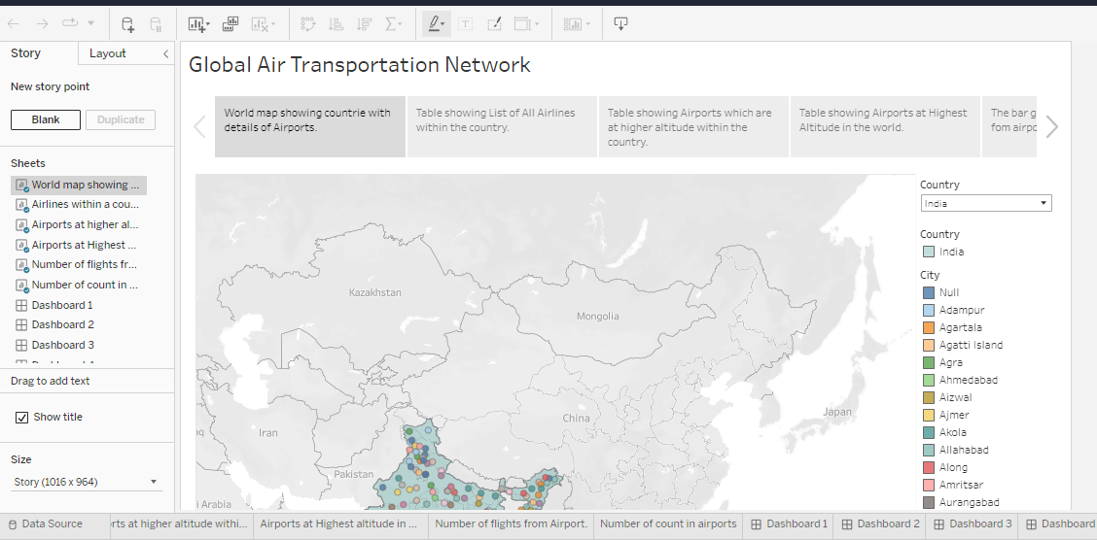

Slide 11
4. ADVANTAGES & DISADVANTAGES
4.1 ADVANTAGES
High speed. Air is the type of freight capable of travelling long distances in short periods of time.
Fast service.
Send almost everywhere your freight.
High Standard of Security.
Natural Route.
There is less need for heavy packaging.
Deliver items quickly over long distance.

Slide 12
4.2 DISADVANTAGES
Risky.
Cost.
Some Product Limitation.
Capacity for small carriage.
Enormous investment.

Slide 13
5. APPLICATIONS
Modeling air transport network aims airline companies to organize their routes in a cost-efficient way and therefore maximize their profits.
Air transport network models are also the tool to investigate system robustness. They help to determine weaknesses of the system in case of various kinds of disruptions.
An alternative application is modeling human disease networks.
Once weaknesses are determined, a substitute node which can support all or part of the traffic load can be identified through the alternative strength for the pair.

Slide 14
6. CONCLUSION
As the industry continues to evolve, IATA will remain an important player in shaping the future of air transport. In conclusion, the International Air Transport Association has been instrumental in developing and improving the air transport industry.

Slide 15
7. FUTURE SCOPE
Emerging technologies are reshaping with robotics, artificial intelligence, the internet of things, unmanned aircraft systems and the push for hybrid and electric airplanes – just to name a few. Alternative fuels can significantly change the current scenario of aviation in support of the environment protection.

